Slide 1
Spectral and Hydrodynamic Analysis of West Nile Virus RNA—
Protein Interactions by Multiwavelength Sedimentation Velocity in the Analytical Ultracentrifuge
By Jin Zhang, et al.
Presented by Nick O’Connor

Slide 2
Presentation Layout
Abstract and Background
Compounds of Interest: West Nile Virus RNA and Human TIAR
Methods
Analysis
Results
Conclusion

Slide 3
Abstract and Background
Interactions between nucleic acids and proteins is incredibly important for many cellular processes, and the study of them is at the forefront of many areas within biochemistry, cellular biology, and virology.
This study introduced a new analytical method based on sedimentation velocity analytical centrifugation (SV-AUC) by combining it with the then novel multiwavelength (MWL) detection setup.
SV-AUC is utilized here to determine both the stoichiometry and molar mass of a complex between a stem loop of West Nile Virus RNA (WNV-RNA) and human TIAR (hTIAR).
MWL-AUC can separate spectral signatures of each species to clearly identify sedimentation information, as long as the constituents have sufficiently different spectra.
Multisignal analysis of protein-RNA by SV-AUC used to combine Rayleigh interference with UV Absorbance, with limited spectral resolution.
Observation of a range of wavelengths allows solutes to be identified by both hydrodynamic and absorbance data.

Slide 4
West Nile Virus RNA and human TIAR
WNV is a pathogenic flavivirus that causes substantial mortality due to a lack of antiviral therapies.
Human T-cell-restricted Intracellular Antigen-1-Related protein has 3 RNA recognition motifs (RRMs) and is involved in regulating alternative pre-mRNA splicing and cellular translation.
The RRMs bind to AU rich sequences of 3’ untranslated regions, and CU rich sequences of 5’ UTRs. This includes a central loop in the 3’ terminal stem loop of WNV’s negative strand. This protein-RNA interaction facilitates the synthesis of WNV within humans.

Slide 5
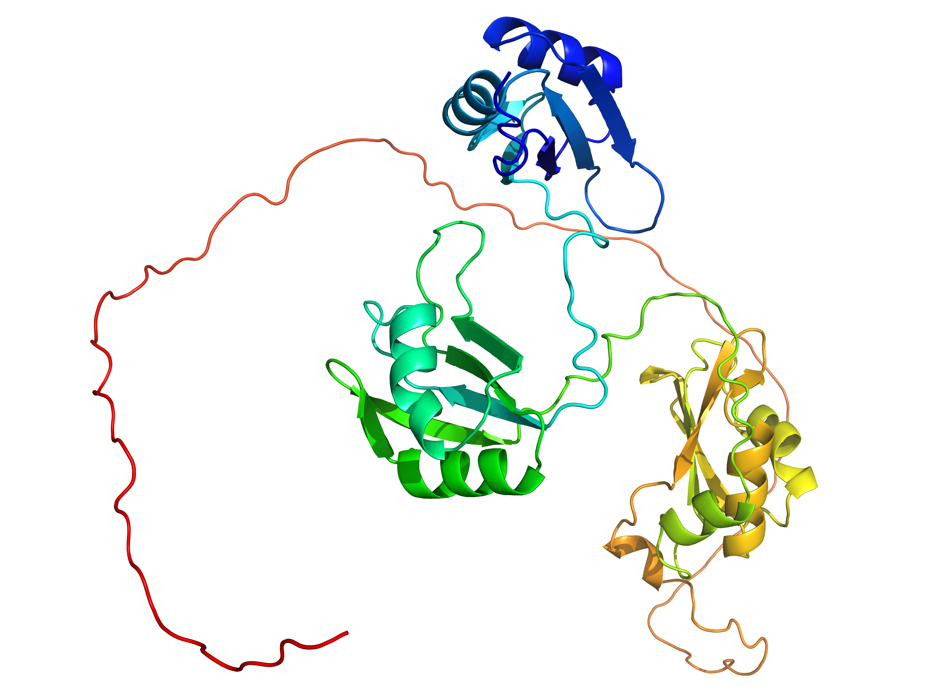
Left (Figure 1):
Predicted secondary structure of the 75 nucleotide WNV-RNA. The sequence of the 20 nucleotide long central loop region of the WNV fragment is marked in red.
Bottom:
AlphaFold structure (AF-Q01085-F1) of hTIAR, colored blue to red, N-Terminus to C-Terminus.

Slide 6
Methods
hTIAR was expressed as a recombinant protein with an N-terminal Glutathione-S-transferase (GST) tag in E. coli strain Rosetta 2(DE3) pLysS cells. Cells were incubated until an Optical Density of 0.6-0.7 at 600nm. Cells were inducted overnight at 20ºC, and then harvested by centrigugation. Cells were lysed with protease inhibitor cocktail tablets, and then spun at 12000g for 30mins at 4ºC. Proteins left in solution were salted out with ammonium sulfate until a final concentration of 70% w/v and pelleted again, then resuspended in PBS. The GST was removed by the site-specific protease PreScission Protease and purified by gel filtration.
WNV-RNA was produced by PCR amplification of a dsDNA template and purified with an anion exchange column and then desalted.
The MWL-AUC was performed in a Beckman Model XL-80K UC with a XL-1 heatsink, equipped with a Model USB 2000 CCD array spectrometer that can measure full UV-Vis (230-700 nm) within 1 ms per spectrum. A xenon flash lamp provided the white light for absorbance and guided by optical fibers and a vacuum feedthrough.
Samples were spun at 20ºC and 60,000 rpm in a buffer of 10 mM sodium phosphate, 50 mM NaCl, and 1 mM TCEP. Spectra ranged from 236 to 294 nm with 1nm increments (59 wavelengths).
Solution | hTIAR Concentration (μM) | WNV-RNA Concentration (μM)
hTIAR Control | 11.6 | 0
WNV-RNA Control | 0 | 1.16
3:1 hTIAR:WNV-RNA | ~3.48 | 1.16
6:1 hTIAR:WNV-RNA | ~6.96 | 1.16
10:1 hTIAR:WNV-RNA | 11.6 | 1.16

Slide 7
Analysis
All data was analyzed by two-dimensional spectrum analysis (2DSA) for an unbiased hydrodynamic model of data at each wavelength. 2DSA also allows floating of the anisotropy (f/f₀) separately from the sedimentation coefficient, and removal of time-invariant and radially invariant noise.
Genetic algorithm analysis was performed on specific spectra to further refine the 2DSA. This is performed by parsimoniously regularizing and optimizes the position of data within the 2D parameter space defined by anisotropy and size.
UltraScan predicted the partial specific volume and extinction coefficient of hTIAR from the amino acid sequence, as well as the buffer density and viscosity. WNV-RNA’s extinction coefficient was determined by the nearest-neighbor method.
Spectral profiles of serial dilutions were found for pure hTIAR, WNV-RNA, and buffer on a benchtop spectrometer and determined to be identical to those from the MWL-AUC in terms of shape and position (though less noisy).
The serial dilution spectra were used to decompose the MWL-AUC data into 3 separate 3D datasets by a Non-Negative Least Squares (NNLS) algorithm.

Slide 8
Figure 2:
NNLS decomposition of MWL-AUC Data. Four-Dimensional MWL-AUC (left) at initial time point, with the meniscus visible on the far left. Each of these is decomposed into the various chemicals (center) resulting in the spectrally separated 3D datasets (right). The different chromophores used for each constituent allow easier determination of the hydrodynamic contributions of each. TCEP is considered for spectral decomposition but does not sediment and only contributes to the baseline.

Slide 9
Analysis
The spectrally separated datasets from Figure 2 were then fitted globally to a 2DSA-Monte Carlo solution, and the 10:1 hTIAR:WNV-RNA experiment was fitted to a global genetic analysis.
Globally fitting both protein and RNA datasets simultaneously fits all hydrodynamically distinct components to a common distribution of sedimentation and diffusion coefficients.
Species will be found in multiple datasets, but the amplitude for each dataset may differ. If the compound isn’t found in a model, then its amplitude will be set to zero.
Once absorption has been converted to molar concentration, the amplitude will be related to the concentration and molar ratios will be directly available

Slide 10
Figure 3:
Global 2DSA-Monte Carlo models obtained from decomposed RNA and hTIAR datasets. Each plot is made of different molar ratios, denoted on the plot, hTIAR in red and RNA in blue.
Increase of hTIAR results in a shift to higher molecular weight complexes, as evidenced by the increasing Sedimentation Coefficient. At 10:1 hTIAR:RNA, additional protein is noted at s=2.45, the same s found in the control run suggesting excess protein is not binding the RNA.
Broad peaks indicate a reaction boundary, and the lack of free peaks matching the controls indicates tight binding of hTIAR to RNA.
All experiments used 1.16 μM RNA, with the control and 10:1 experiment run on 11.6 μM hTIAR, and appropriate concentrations for the 3:1 and 6:1 experiments. All plots are shown as g(s) distributions with dC/ds on the Y-axis.

Slide 11
Figure 3:
By integrating the peaks, molar ratios were found for each compound.
The 3:1 Experiment has a 1.6:1 molar ratio of protein to RNA, centered at 6.43 S.
The 6:1 Experiment has a 4.25:1 molar ratio, centered at 7.69 S.
The 10:1 Experiment is now 4.30:1 molar ratio but has shifted to 8.78 S and is a tighter peak.
The tightening of the peak, as well as the increase in sedimentation coefficient, show the reaction boundary, or the number of intermediate complexes, are decreasing toward one single complex species. The appearance of free protein in 10:1 further supports this theory.
K_{d} is incapable of being resolved from this experiment as it appears to be very low and beyond the detection of this instrument.

Slide 12
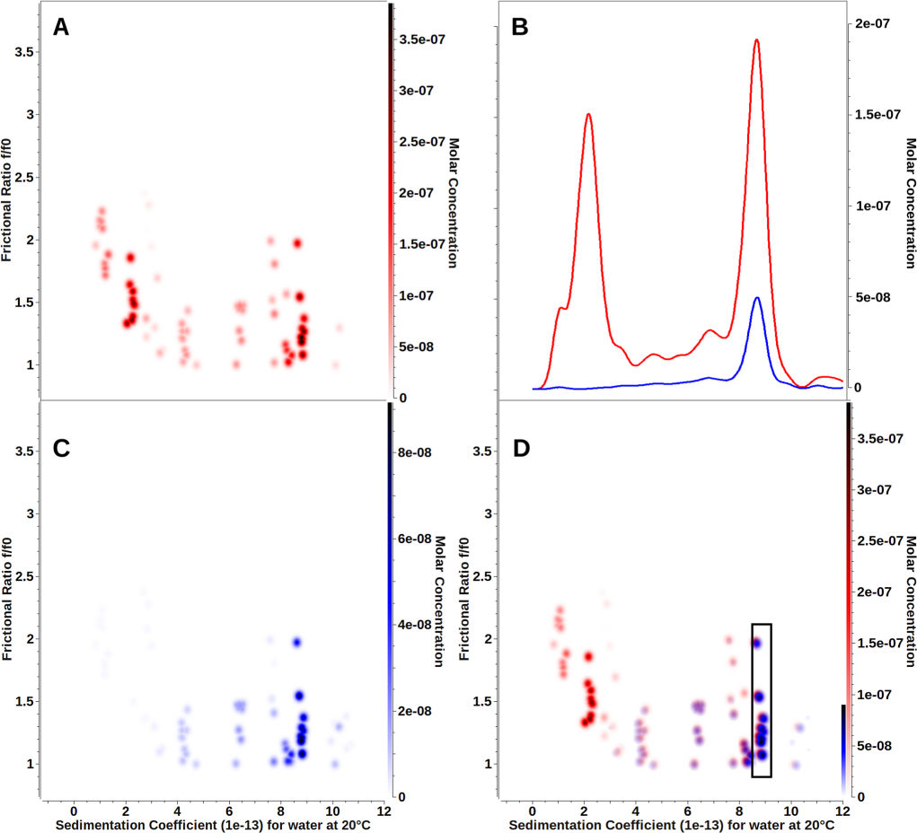
Figure 4:
Global genetic algorithm-Monte Carlo analysis of the 10:1 protein:RNA experiment, protein as red and RNA as blue. Plots A and C shown hTIAR and RNA, respectively, on their own, with D showing the combined plots, while B is the 2DSA-Monte Carlo from Figure 3.
Each dot represents the amplitude of a fitted solute resolved both by size (s_{20,W}) and anisotropy (frictional ratio, f/f₀), with purple dots representing the complex.
Integration limits for the 8.78 S complex are within the black box of D, with all confidence limits being fairly broad due to limits in radial resolution and limited diffusion signal at the selected rotor speed. Anisotropy for free hTIAR is unreliable as the partial specific volume was assumed as consistent with 4:1 for all species.

Slide 13
An ITC isotherm was performed on the complex to compare with the MWL-AUC data. The shape of this curve showed a complex, multi-stage binding ratio and continued to increase up to a 5.5:1 molar ratio, a higher ratio than determined by the MWL-AUC

Slide 14
Conclusion
Increasing the concentration of hTIAR in comparison to WNV-RNA resulted in 3 data trends:
Protein and RNA peaks with increasing sedimentation coefficients
Tightened Peaks
Increase of Protein:RNA molar ratios of the complexed species
A maximum molar ratio of 4:1 Protein:RNA was determined, with additional protein staying uncomplexed and free
This shows MWL-AUC to be a powerful and useful tool to determine binding (especially molar ratios) between species with sufficiently different spectra, but requiring less exacting conditions than NMR or X-Ray Crystallography.

