Slide 1
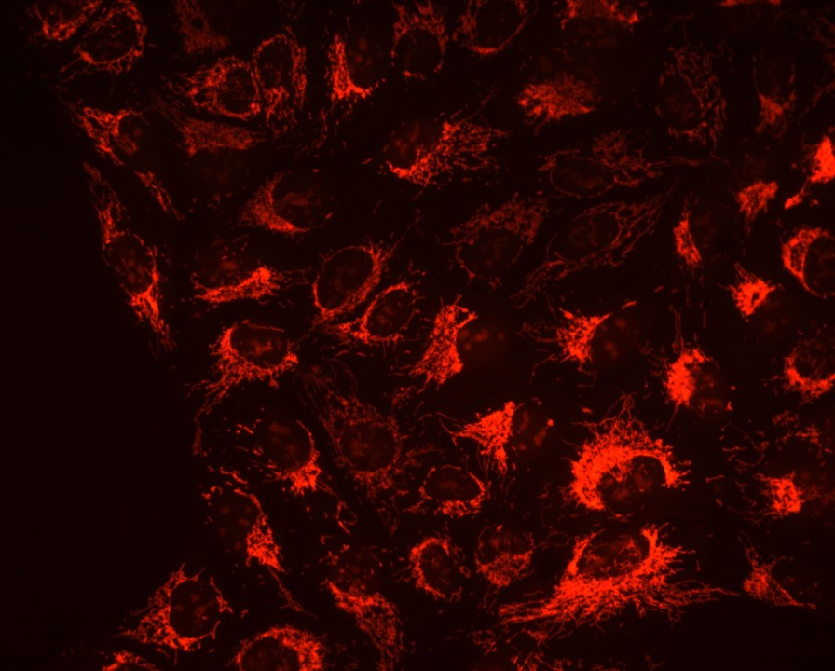

In vivo mouse and live cell STED microscopy of neuronal actin plasticity using far-red emitting fluorescent proteins
Waja Wegner, Peter Ilgen, Carola Gregor, Joris van Dort, Alexander C. Mott, Heinz Steffens, & Katrin I. Willig.
Biophysics 4850
Liam Kerr

Slide 2

Background
Dendritic spines
STimulated Emission Depletion (STED)
Far red emitting fluorescent proteins
Objectives

Slide 3
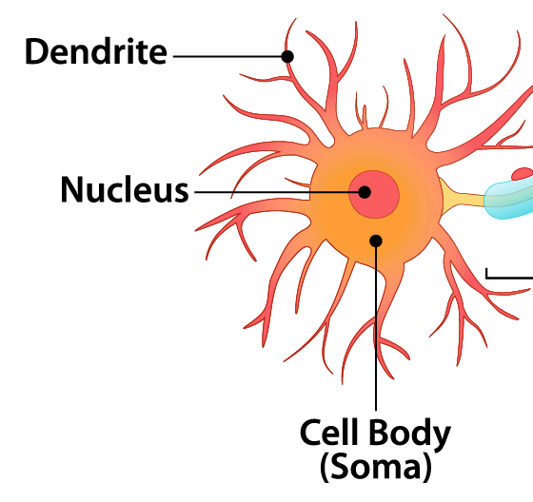
Dendritic Spines and Why They Matter
Neuronal synapses are the basic communication function within the brain
Dendrites play a crucial role in synapse connection, it is believed that dendritic spines protruding from dendrites have important roles in post synaptic function such as synaptic storage (function is not fully known)
Spines morphology and function is highly dynamic and has been seen to change with age
Visualization of these minute synaptic structures while in live networks can help to further the understanding of their function

Slide 4

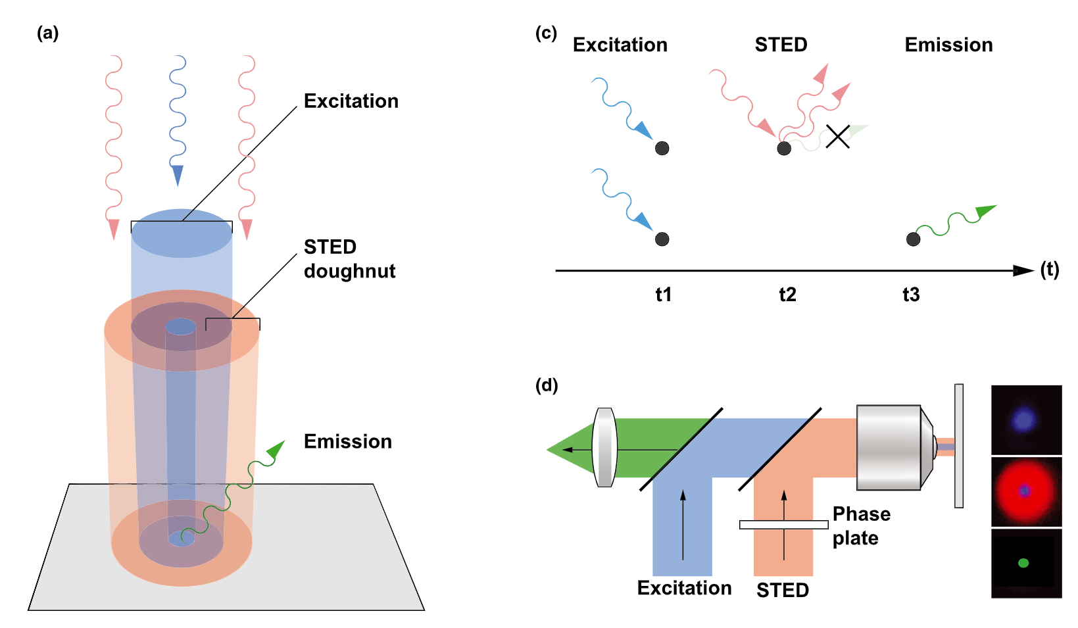
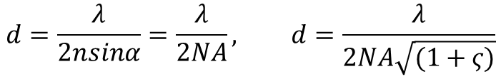
STED
STimulated Emission Depletion, can overcome diffraction limit and allows for super resolution imaging
Uses excitation laser set to fluorescent protein (FP) of interests optimal wave length to excite FP
Uses depletion laser in area around focal point to return background fluorescence to the ground state
Records emission of excited fluorophores and can create images with ~50 nm resolution
$$d=\frac{λ}{2nsinα}=\frac{λ}{2NA}, d=\frac{λ}{2NA\sqrt{(1+ς)}}$$
H. Bolm, H. Bismar (2014)

Slide 5
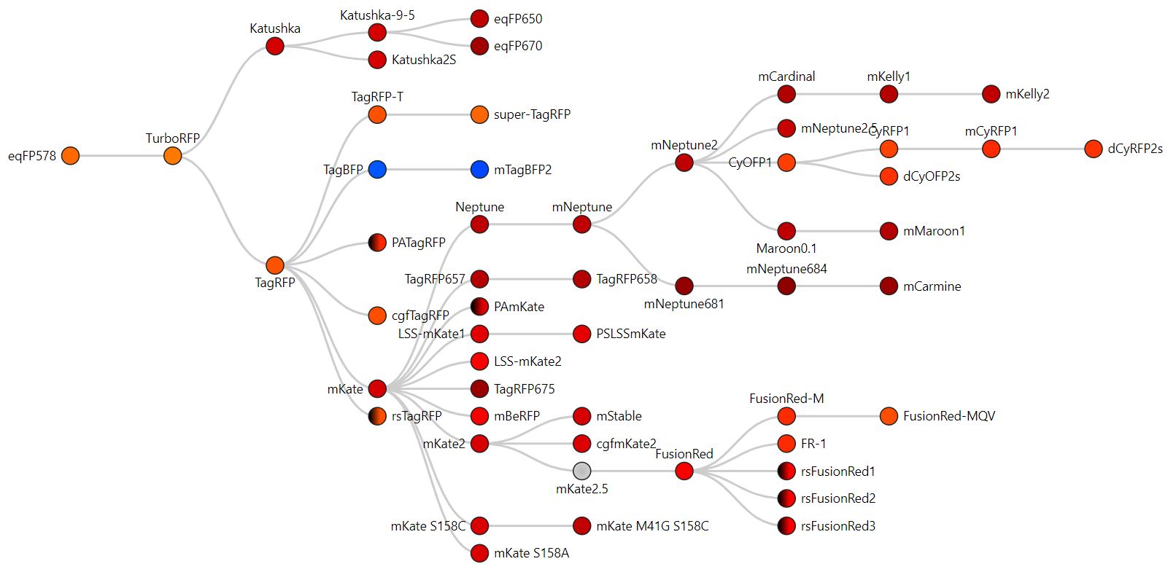
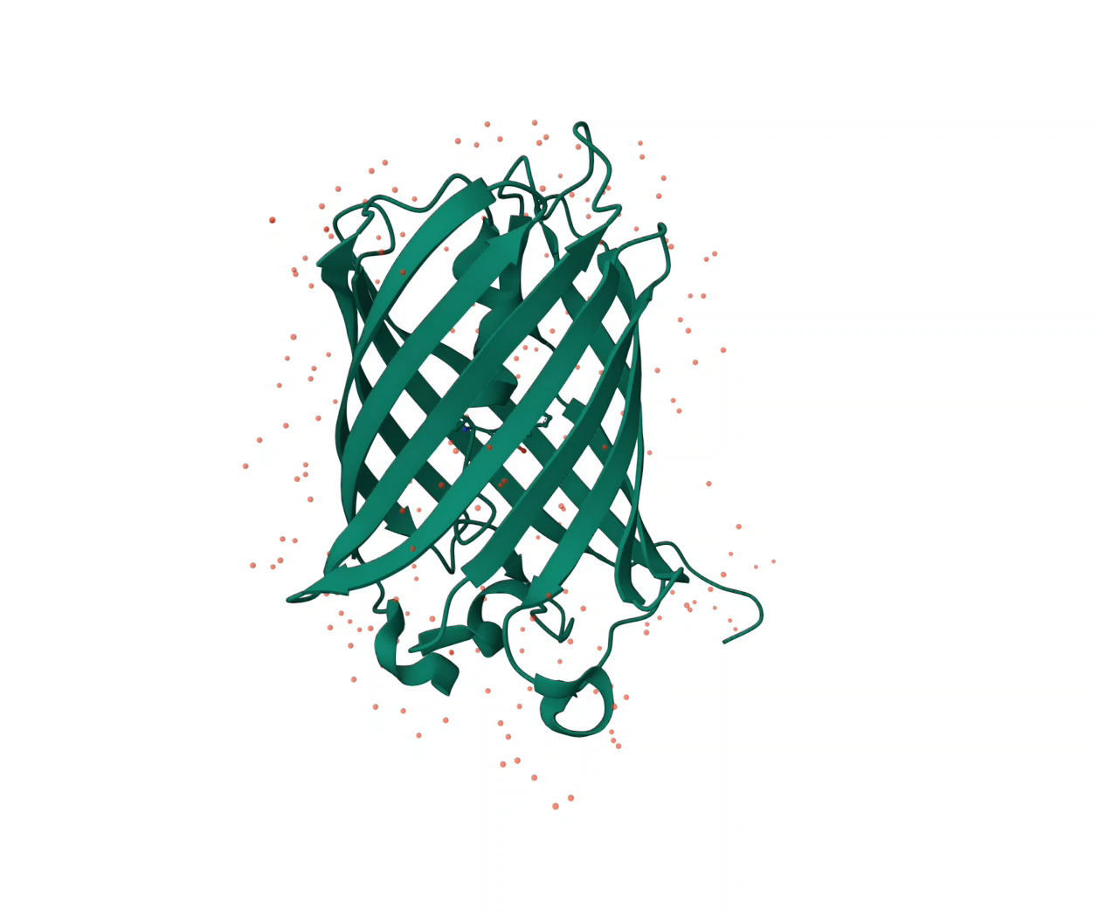
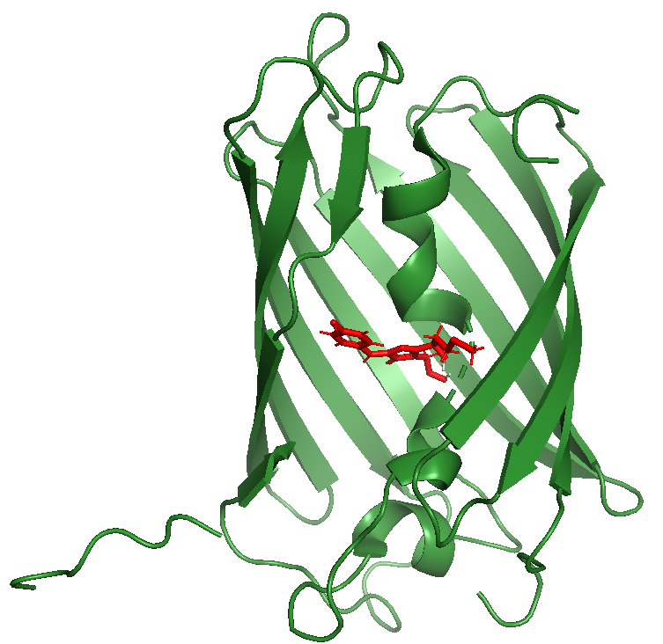
Far red emitting Fluorophore’s
mNeptune
mNeptune2
mCardinal
tagRFP657
mCardinal

Slide 6
Objective’s
Find far red emitting FPs that have high quantum yield, low photobleaching and no phototoxic stress
1
Determine STED resolution, labeling efficiency and density of FP
3
Determine best expression level of FP for best detail imaging
4
Find Actin binding proteins that don’t cause morphological changes of dendritic spines
2

Slide 7
Methods
Selection of red FP
Selection of actin binding proteins
Label dendritic spines
STED imaging of dendritic spine in cells and in vivo

Slide 8
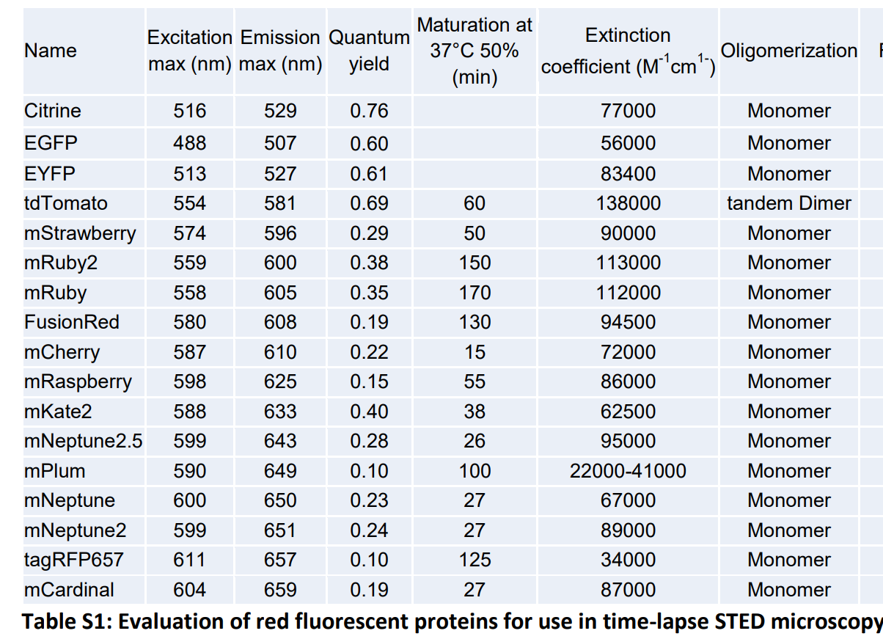

Selection of Fluorophore proteins (FP)
Need to have low phototoxicity and photobleaching, red shifted emission is more desirable ~650 nm
High quantum yield is more desirable Φ=1
$$φ=\frac{N_{photons emitted}}{N_{photons absorbed}}$$

Slide 9
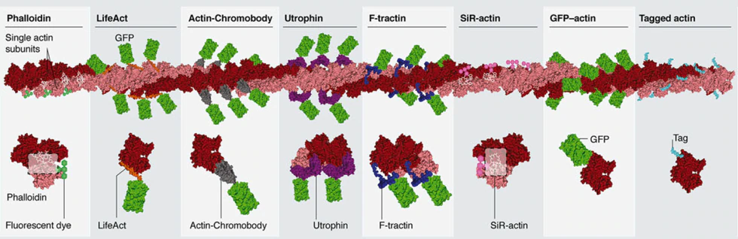
Lifeact & Actin chromobody
Lifeact is a short actin binding peptide that binds to Filamentous actin (F-actin) hydrophobic binding pocket
Actin Chromobody is an actin nanobody that has a F-actin specificity domain.
Phalloidin is golden standard for labeling actin as it has a high affinity, downsides are low cell permeability and once bound, actin becomes fixed and cell morphological change can't be observed
M. Melak, et al (2017)

Slide 10
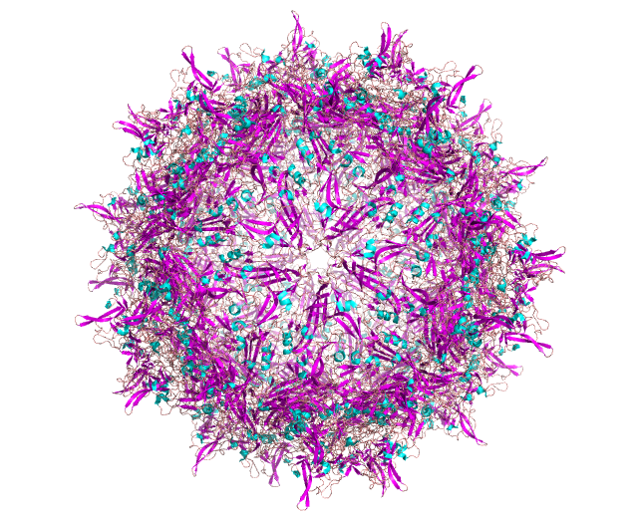
Labeling of Dendritic Spines
Adeno virus is a non enveloped dsDNA virus that can be engineered to have no viral genome but instead contain DNA of interest
Use of Adeno Associated viral particles (AAV) to deliver DNA plasmid of interest into neuronal cells
Created plasmids that contained the coding sequence for either lifeact or actin chromobody and FP fusions and inserted into AAV which can then be injected into sample cells which begin transcribing and translating

Slide 11
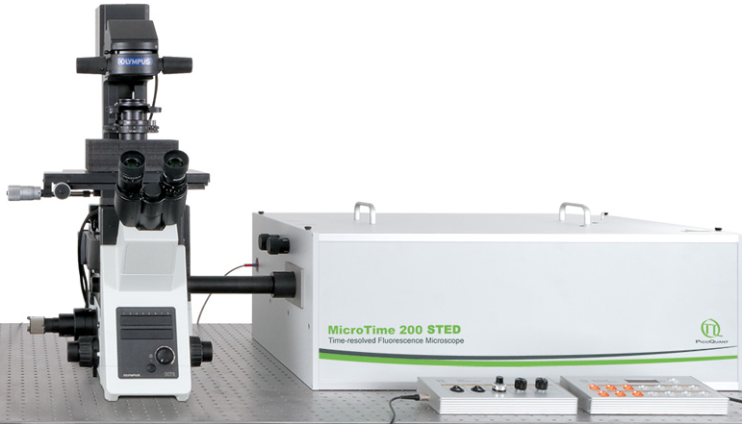
STED Microscopy of Live Cells and In vivo
Neuronal hippocampal cell cultures were grown on poly-L-Lysine plates for 11 days before being induced with the created AAV constructs, after 10 days cells were imaged using the built STED inverted microscope
For In vivo experiments 150 nL of AAV constructs were injected into layer 5 (L5) of the cranial cortex of a mouse, after 3 weeks a craniotomy was performed at the injection site, a watch glass was placed over the opening, and imaging was then performed using an upright STED microscope

Slide 12

Results and Conclusion
labeling of dendritic spines in neuronal cell culture
In vivo labeling of dendritic spines
Labeling density
Effects of labeling on dendritic spine detail

Slide 13
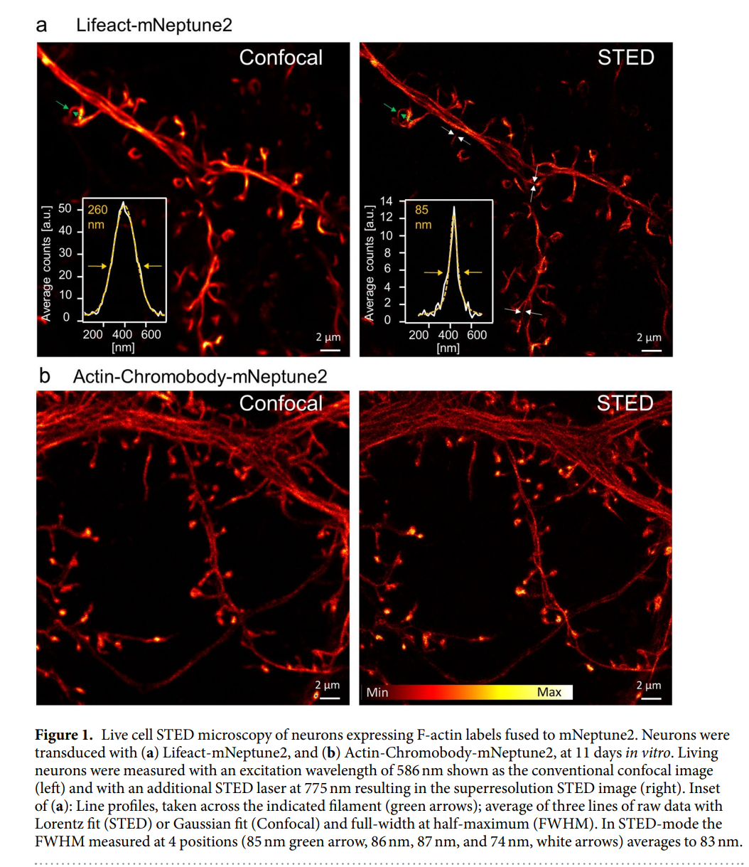
Suitability of mNeptune2 and actin binding
Use of Lifeact and Actin chromobody with mNeptune2 allows for long term STED microscopy with a 83 nm resolution

Slide 14
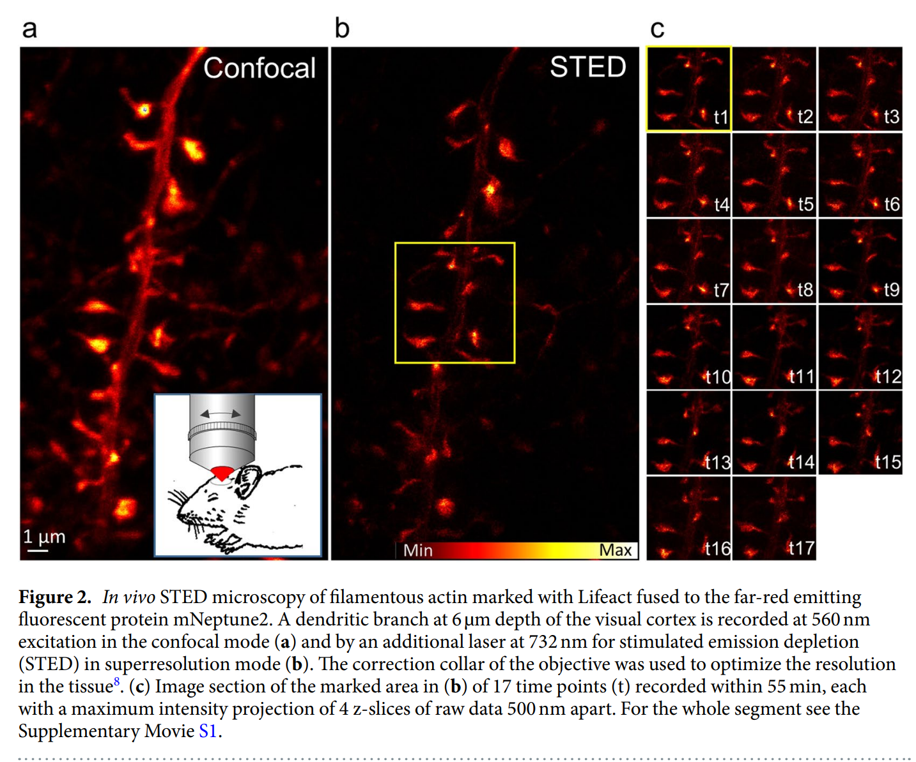
In vivo imaging of dendritic spines
STED creates higher detail of dendritic spines than confocal
Time lapse shows morphological change over 1 hour and no phototoxic stress on spines

Slide 15
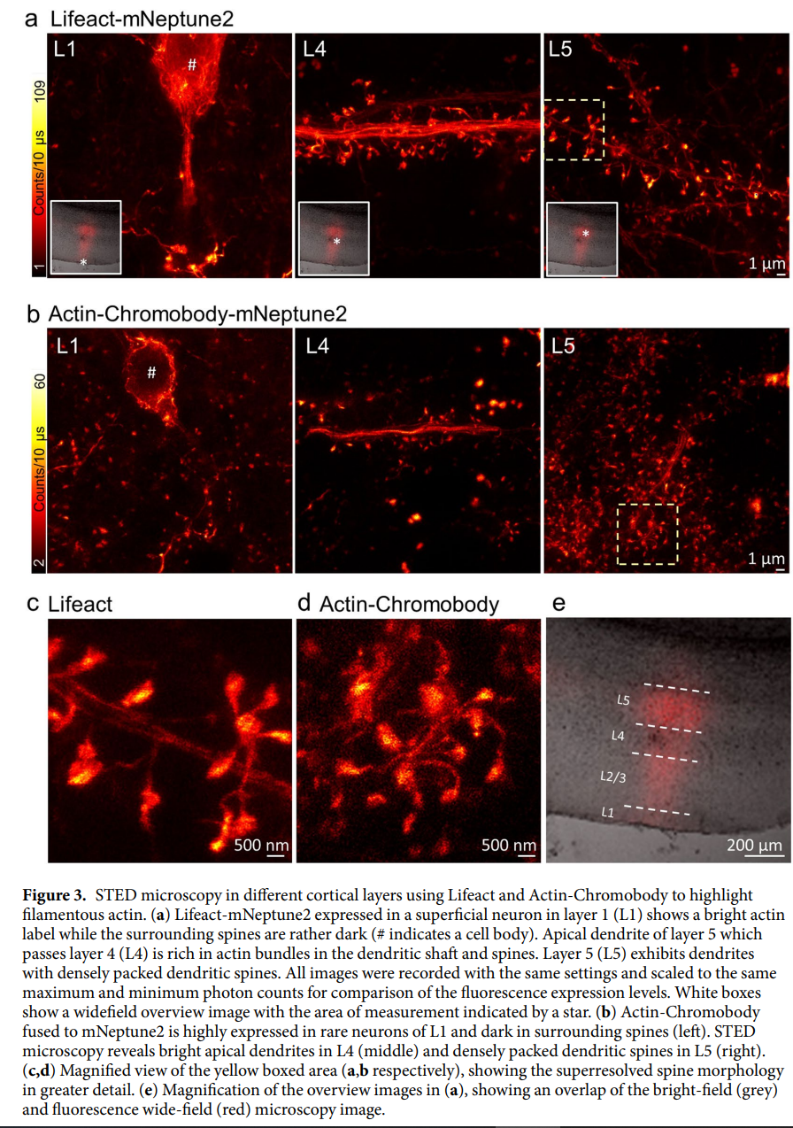
Labeling Density
Dense fluorescence due to pyramidal dendrites with packed dendritic spines in layer 5
Bright spines in layer 1 are due to soma while faint specs are due to distal layer 5 spines

Slide 16
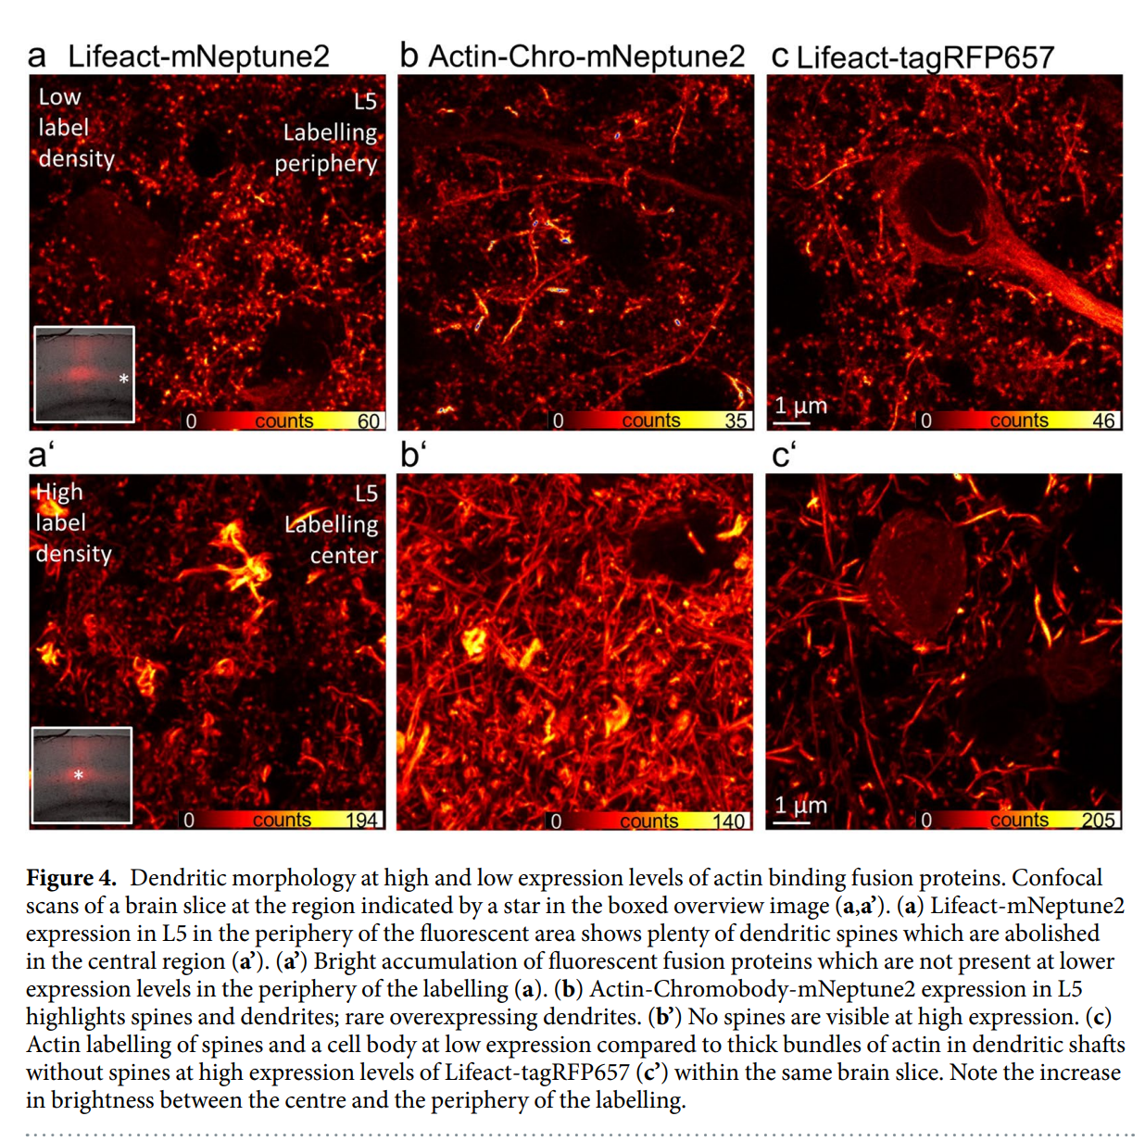
Over expression of actin binding proteins
Over expression of both lifeact and actin chromobody caused loss of spine detail and accumulation of FP
Low expression still allows for detailed visualization

Slide 17
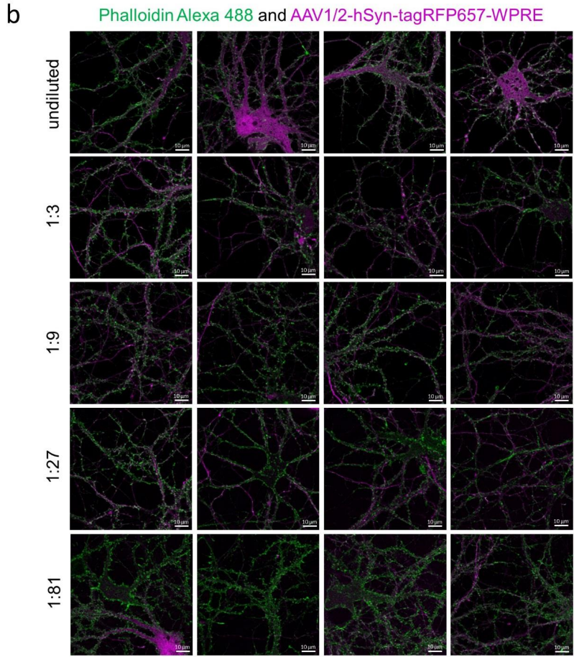
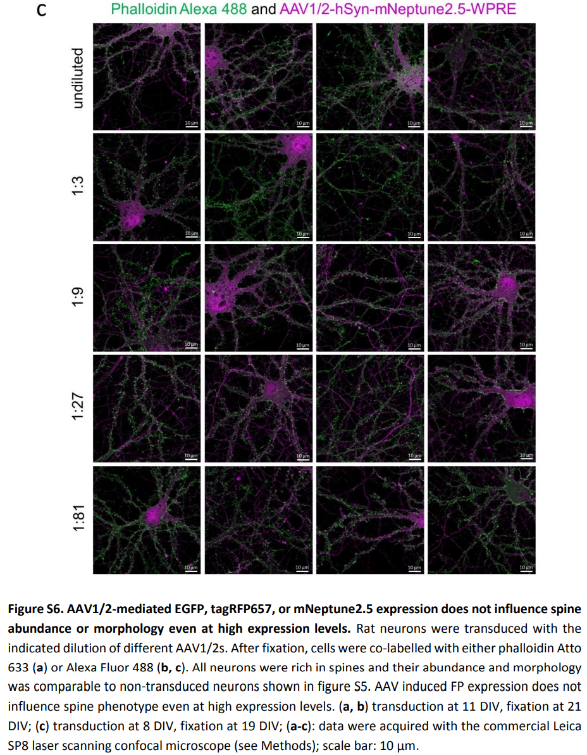
Overexpression of FP
Overexpression of fluorescent proteins showed no loss of spine visualization
Using phalloidin in the presence of various FP expression levels showed no change in spine morphology or loss of detail

Slide 18
Discussion/ Future directions
High expression of Lifeact and actin chromobodies causes morphological changes and accumulation of FP bodies
Lifeact and actin chromobodies labeling isn’t identical as lifeact binds more to dendric shafts
Red emission FP have darker emission in distal dendrites compared to proximal ones, which when compared to GFP doesn’t occur
Red emission FP produce a lower emission intensity when compared to GFP

Slide 19
Summary
From the super resolution of ~83 nm, STED is an ideal tool for imaging synaptic networks while being able to observe mobility using time lapse imaging
Far red emitting proteins like mNeptune2 prove to be advantageous as they don’t cause phototoxicity
Both Lifeact and actin chromobodies show good specificity for actin binding without causing morphological changes optimally at low expression

Slide 20
Thank You
References
1. W. Wegner, et al., In vivo mouse and live cell STED microscopy of neuronal actin plasticity using far-red emitting fluorescent proteins https:/doi.org/10.1038/s41598-017-11827-4 (Sept 18, 2017).
2. C. Li, R. J. Samulski, Engineering adeno-associated virus vectors for gene therapy. Nat Rev Genet 21, 255–272 (2020).
3. A. Belyyid, F. Merinoid, O. Sitselid, S. Raunserid, Structure of the Lifeact-F-actin complex (2020) https:/doi.org/10.1371/journal.pbio.3000925 (2020).
4. M. F. Naso, B. Tomkowicz, W. L. P. Iii, W. R. Strohl, Adeno-Associated Virus (AAV) as a Vector for Gene Therapy (2017) https:/doi.org/10.1007/s40259-017-0234-5 (2017).
5. H. Blom, H. Brismar, STED microscopy: Increased resolution for medical research? J Intern Med 276, 560–578 (2014).
6. M. Melak, M. Plessner, R. Grosse, Correction: Actin visualization at a glance. J Cell Sci 130, 1688 (2017).
7. G. Vicidomini, P. Bianchini, A. Diaspro, STED super-resolved microscopy. Nature Methods 2018 15:3 15, 173–182 (2018).
8. https://mhanational.org/neurons-how-brain-communicates

Slide 21

Questions?

