Slide 1
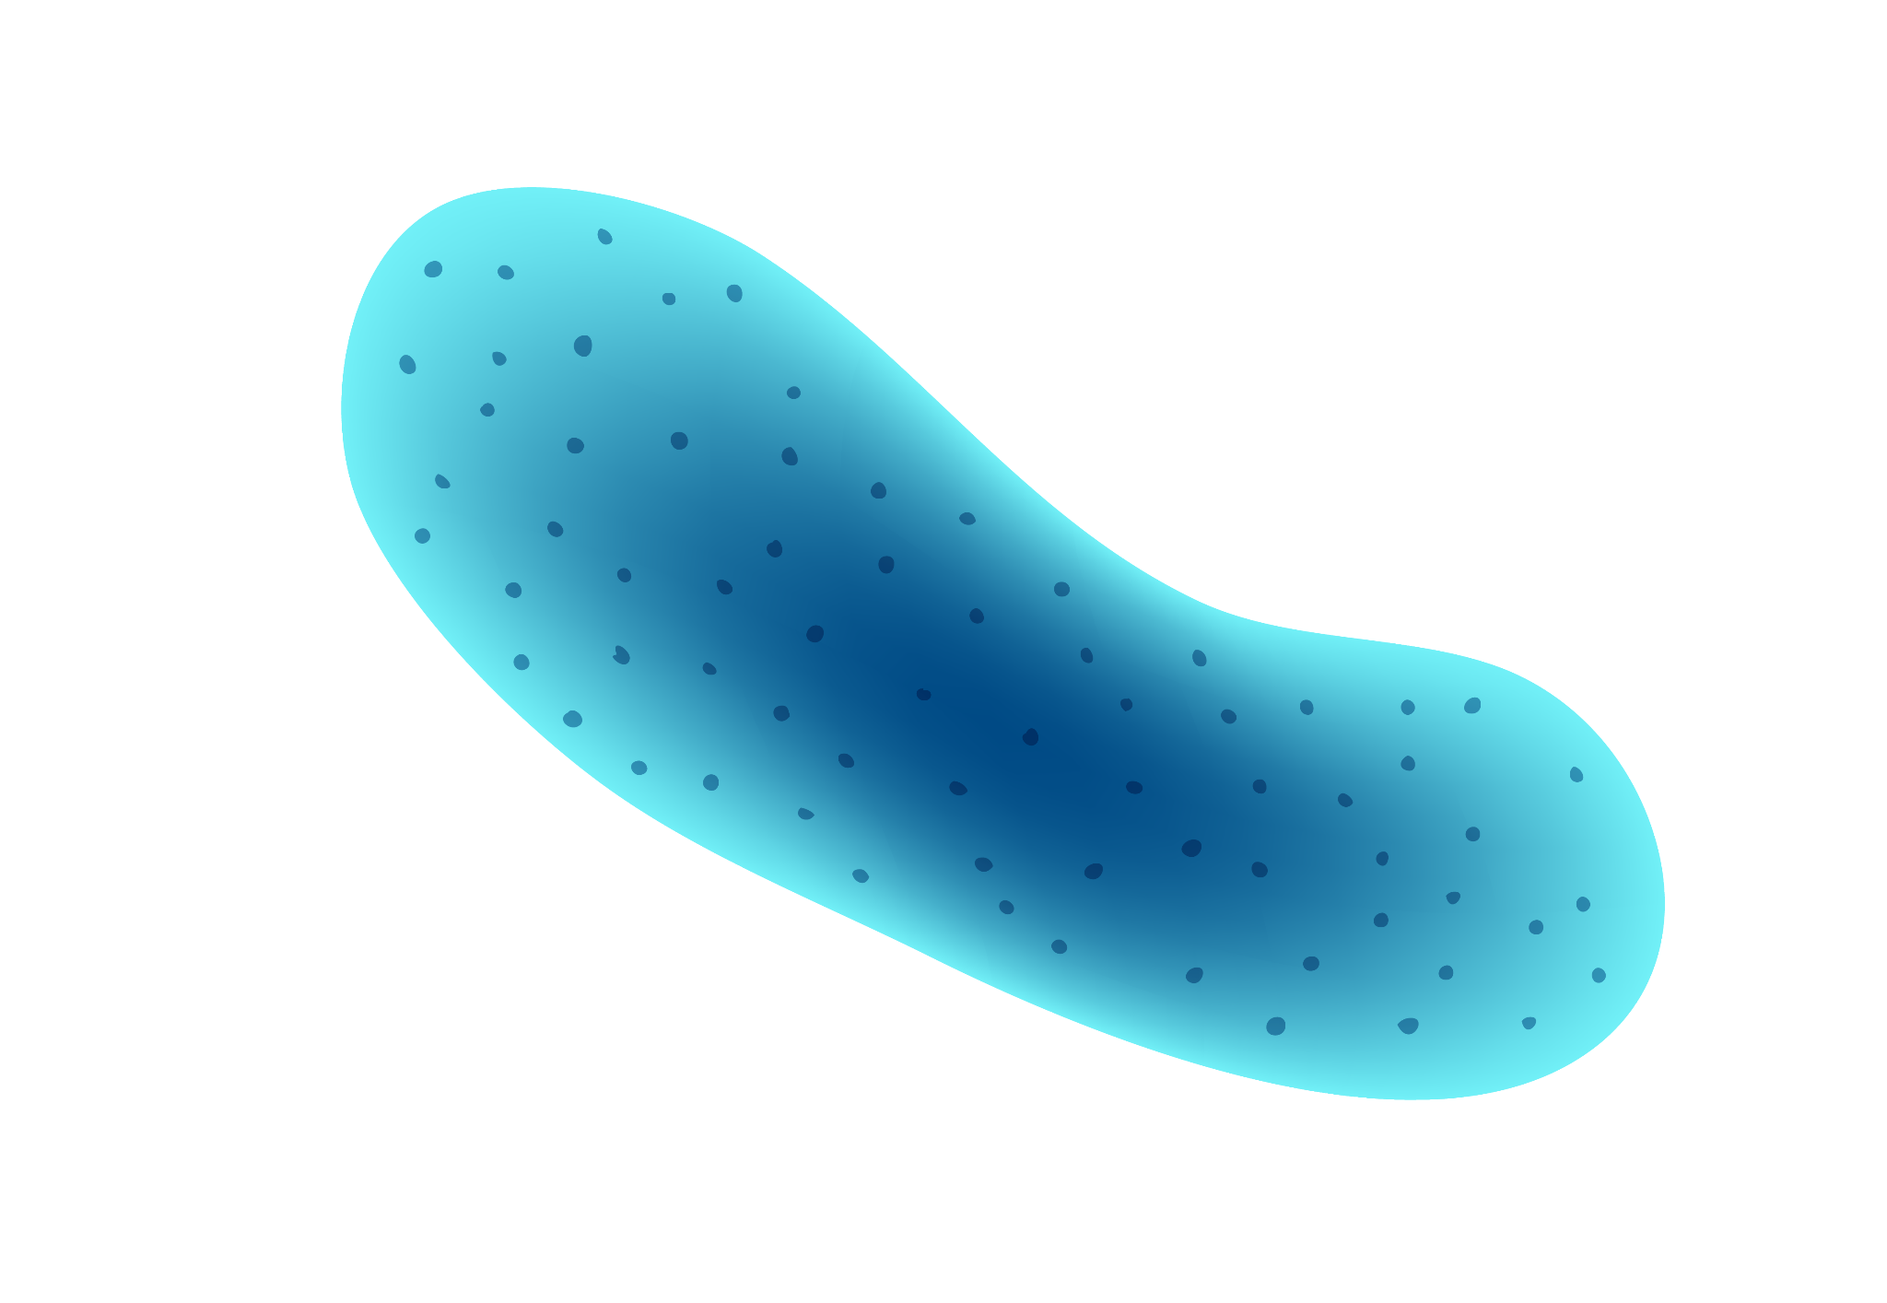
Super Resolution Flourescence Localization Microscopy
MJ Mlodzianoski, MM Valles, and ST Hess, University of Maine, Orono, ME, USA
Presented by: Uvindu C. Abeysekara
March 13, 2023

Slide 2
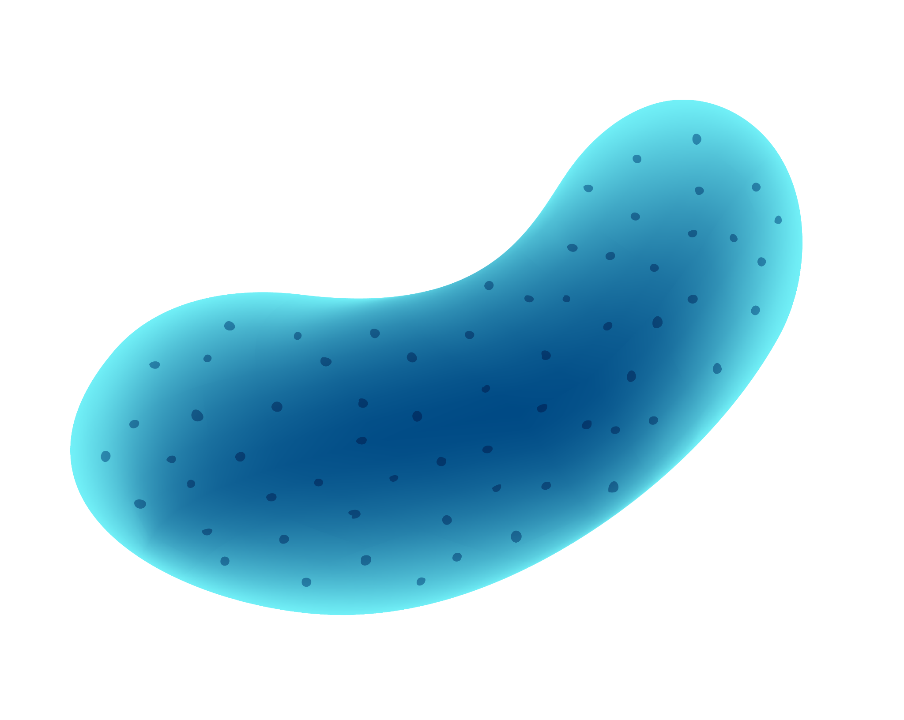
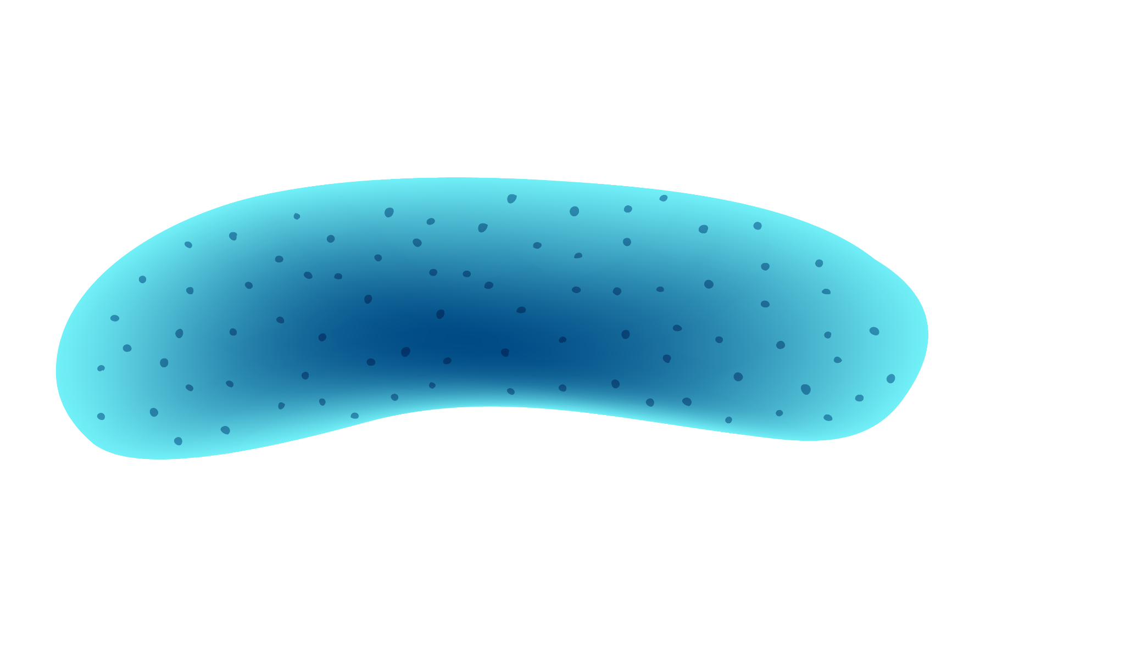
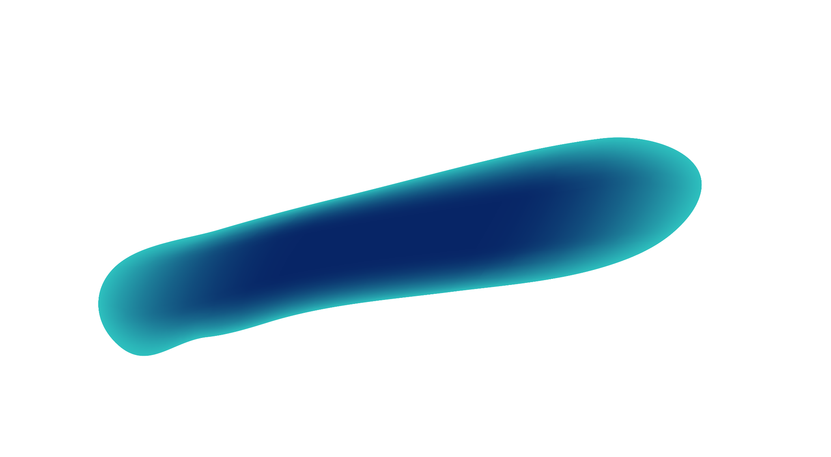
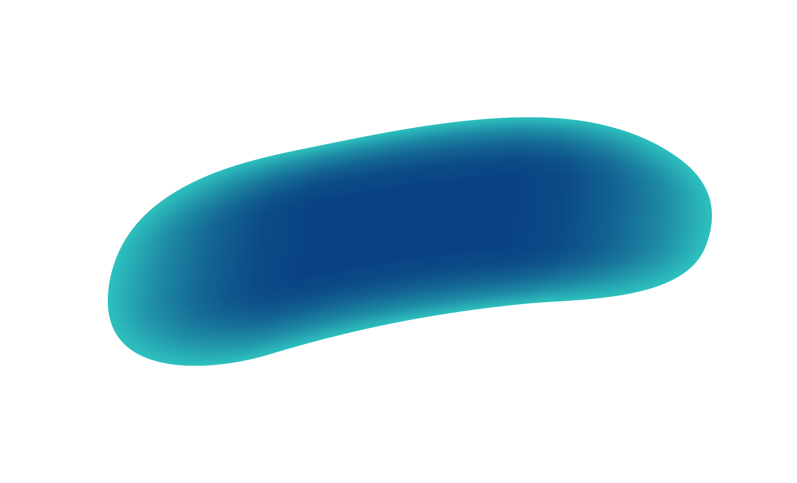
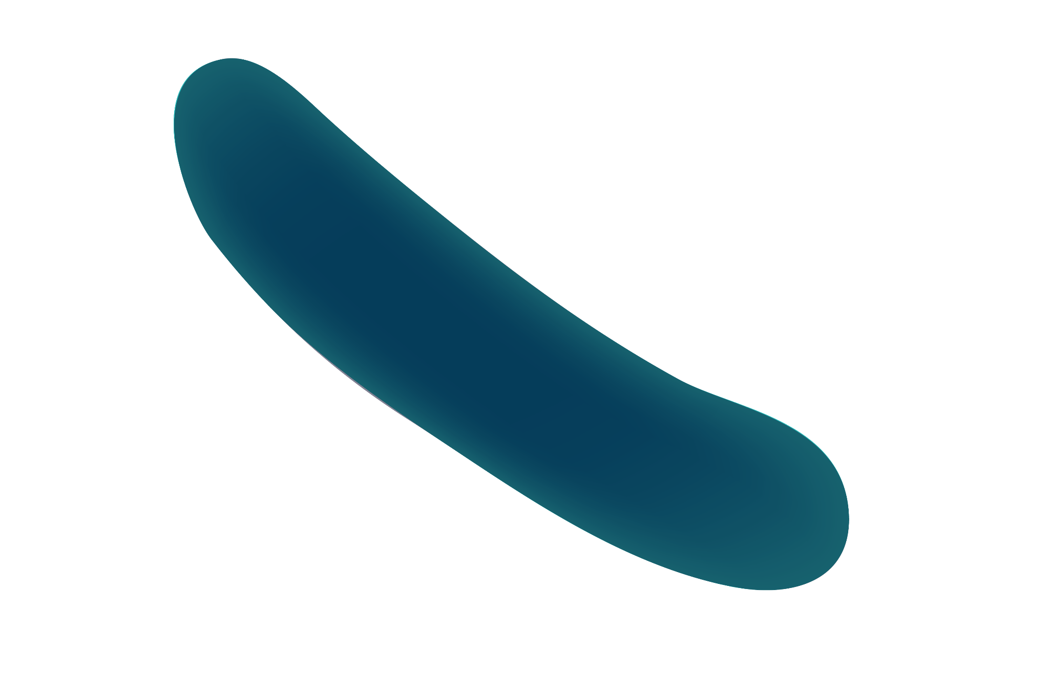
01
OBJECTIVES
Demonstration/Explaination of how Super Resolution Fluorescence localization Microscopy useful for imaging living and fixed cells.
BREAKTHROUGH
Notes:
And biological samples

Slide 3
Important terms
Localization: The two- or three-dimensional positional
determination of a point source.
Resolution: The smallest distinguishable distance between
Two points.
Notes:
Localization: pretty much the area where the fluorescence stands out compared to the back ground
Resolution:

Slide 4
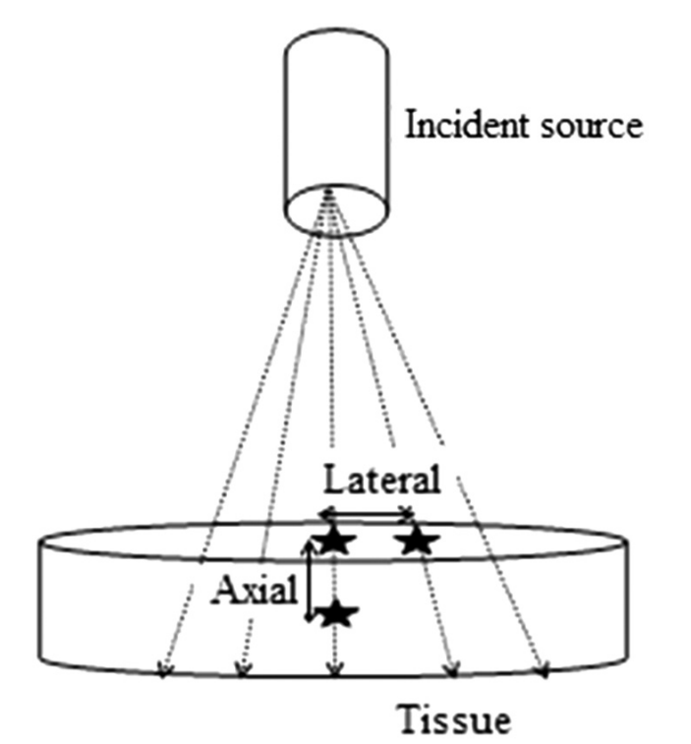
INTRODUCTION
Far field fluorescence by itself can only have resolutions
of about 200 nm and 600 nm lateral and axial
resolution respectively.
Meaning it is diffraction limited.
By combining it by Localization microscopy resolution after processing can be improved upon and overcome the limit.
Figure 1. Axial and Lateral resolution.
(Thapa et al., 2014)

Slide 5
Types of Super Resolution localization techniques
Stochastic optical reconstruction microscopy (STORM)
uses fluorescent probes to localize individual molecules with nanometer precision, allowing for high-resolution imaging beyond the diffraction limit. (Rust et al., 2006)
Photoactivatable localization microscopy (PALM)
uses photoactivatable fluorescent proteins to spatially separate individual molecules and obtain high-resolution images of biological structures. (Betzig et al., 2006)
Fluorescence Photoactivation Localization Microscopy (FPALM)
uses photoactivatable fluorescent molecules to track and localize individual molecules, enabling high-resolution imaging of biological structures in live cells. (Hess et al., 2006).

Slide 6
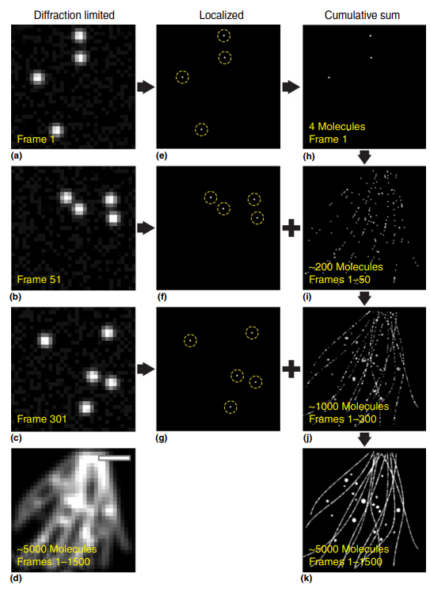
Concept
There are two sets of lasers
Activation laser
Readout laser
Then images are analyzed and localized to give a more precise resolution.
Figure 2. Processing of image through FPALM
Notes:
Activation laser is a higher powered laser which excites the molecules (causes a photochemical reaction) to a meta stable state
Read out laser controls the bleaching rates of individual molecules
Bar is 1 um
Starts with bleached photo.

Slide 7
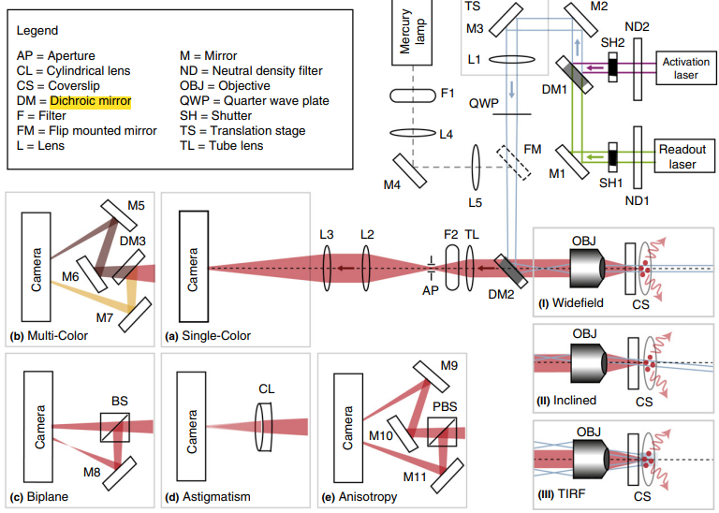
METHODS
Figure 3. FPALM setup and applications
Notes:
Top right as previously mentioned the Activation laser and readout laser in this case was
- Activation set at 405nm but the read out laser depends on the fluorescent molecule used
- SH1 and SH2 are the shutters control when which one is used
- Another important feature is L3 and L2 which together act as a magnifier.

Slide 8
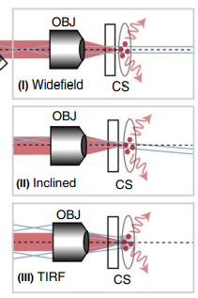
METHODS
(1) Widefield
Laser goes through the sample exciting throughout it
(2) Inclined
Demonstrates that when dichroic mirror 2 is shifted it can bend the path of light
(3) TIRF mode
- When the dichroic mirror is bent enough it goes into TIRF mode. This allows for the study of the surface of the sample.
Figure 4. Shifted paths of light
Notes:
Dotted line is optical axis
Reduces background interference as well.

Slide 9
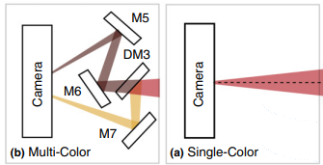
METHODS
Figure 5. 2-D localization methods Multi-color and Single-color setup
Multi-color
-Done with multiple fluorescent molecules
- Utilizes multiple mirrors for each fluorescent
Single-color
-Done with one fluorescent molecule
Notes:
Both are 2-d localization data.

Slide 10
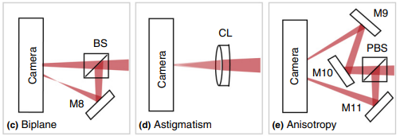
METHODS
Figure 6. 3-D localization methods, Biplane, Astigmatism and Anisotropy setup
Biplane
- 50:50 beam splitter cube used giving 2 readings allowing for 3-D localization
Astigmatism
-cylindrical len is utilized
- Based on the stretch localization can be calculated.
Anisotropy
-Utilizes a polarizing beam splitter cube
- More than 3-D localization allows for the identification of the angle the sample is in.
Notes:
These methods help measure axial localization therefore allowing for 3-D localization
Astigmatism much like my eyes

Slide 11
Data analysis
1. Several thousands of frames are combined together of each molecule
2. Background noise subtraction
3. Molecules identified and localized
- using Gaussian maximum-likelihood estimation
4. Final render of all localized individual molecules
Figure 2. Processing of image through FPALM
Notes:
Calculated by variation of detected fluorescence and not detected.
Gaussian maximum likelihood estimation (GMLE) is a method for estimating the parameters of a Gaussian distribution based on a set of observed data points. In the context of super resolution fluorescence localization microscopy (SRLM), GMLE is commonly used to determine the position of individual fluorescent molecules with high precision.
In GMLE, the position of a single fluorescent molecule is modeled as a two-dimensional Gaussian distribution, with the mean corresponding to the true position of the molecule and the standard deviation representing the localization precision. Given a set of observed image data points, GMLE seeks to find the parameters of the Gaussian distribution that best match the observed data.
The GMLE algorithm works by first estimating the background noise level and subtracting it from the observed data. Then, for each observed data point, the algorithm calculates the likelihood of the data point given a set of potential Gaussian distributions with different mean positions. The algorithm then selects the Gaussian distribution with the maximum likelihood as the estimate for the position of the fluorescent molecule.
By repeating this process for each observed data point, GMLE can provide high-precision estimates of the positions of individual fluorescent molecules. GMLE has been shown to be a powerful tool for single-molecule localization in SRLM and is commonly used in conjunction with other algorithms and techniques to achieve super-resolution imaging.

Slide 12
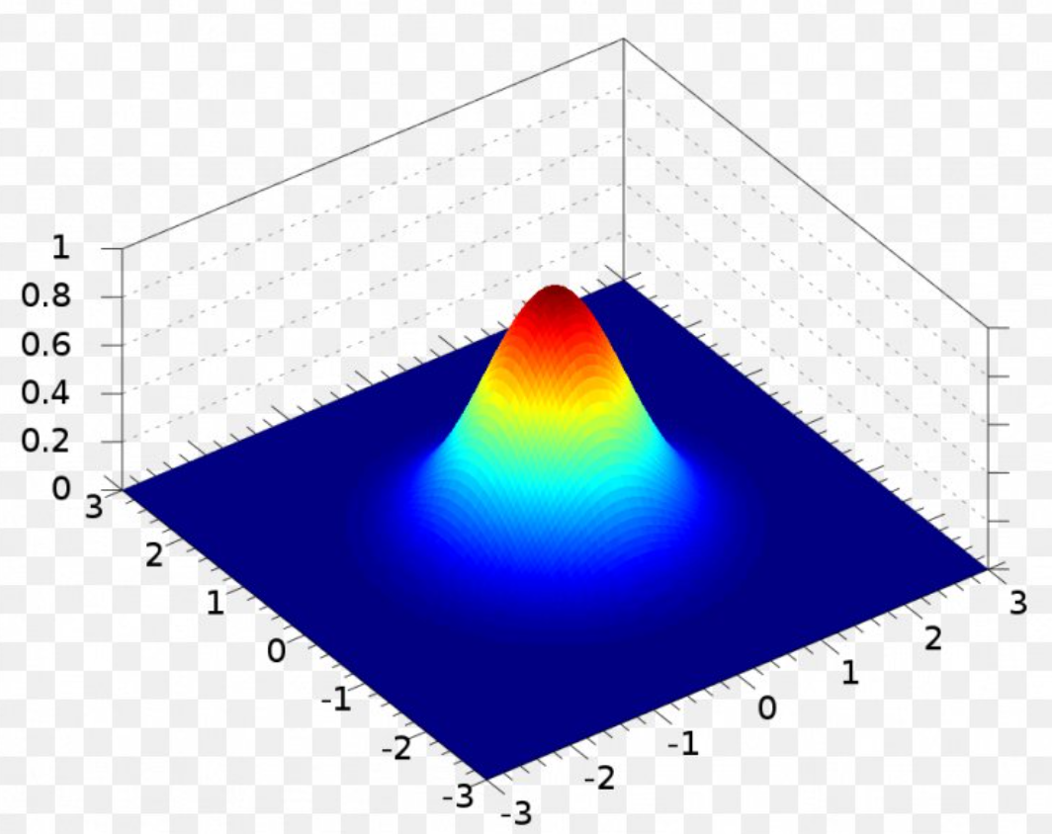
Gaussian maximum likelihood estimation (GMLE)
- Mean is recorded as the point molecule exists
-Standard deviation represents the precision of localization
Figure 7. two dimensional Normal Gaussian distribution
Notes:
Gaussian maximum likelihood estimation (GMLE) is a method for estimating the parameters of a Gaussian distribution based on a set of observed data points. In the context of super resolution fluorescence localization microscopy (SRLM), GMLE is commonly used to determine the position of individual fluorescent molecules with high precision.
In GMLE, the position of a single fluorescent molecule is modeled as a two-dimensional Gaussian distribution, with the mean corresponding to the true position of the molecule and the standard deviation representing the localization precision. Given a set of observed image data points, GMLE seeks to find the parameters of the Gaussian distribution that best match the observed data.
The GMLE algorithm works by first estimating the background noise level and subtracting it from the observed data. Then, for each observed data point, the algorithm calculates the likelihood of the data point given a set of potential Gaussian distributions with different mean positions. The algorithm then selects the Gaussian distribution with the maximum likelihood as the estimate for the position of the fluorescent molecule.
By repeating this process for each observed data point, GMLE can provide high-precision estimates of the positions of individual fluorescent molecules. GMLE has been shown to be a powerful tool for single-molecule localization in SRLM and is commonly used in conjunction with other algorithms and techniques to achieve super-resolution imaging.

Slide 13
Discussion/Future Directions
-Choosing correct excitation frequency is very important
-Programs to quantify the number of molecules are in development
-Methods to maximize fluorescence detection and reduce background fluorescence are extremely important to develop
One thing is that the program’s capabilities still limit it.
Another issue is that the fastest data can be recorded is 0.03s with an organic dye.
Notes:
The Nyquist sampling theorem states that in order to accurately reconstruct a signal, it must be sampled at least twice the highest frequency contained in the signal.
The Fourier ring correlation (FRC) method is a quantitative measure used to assess the resolution and image quality of super-resolution microscopy images by comparing the Fourier transform of two half images.

Slide 14
References
Betzig, E., Patterson, G. H., Sougrat, R., Lindwasser, O. W., Olenych, S., Bonifacino, J. S., Davidson, M. W., Lippincott-Schwartz, J., & Hess, H. F. (2006). Imaging Intracellular Fluorescent Proteins at Nanometer Resolution. Science, 313(5793), 1642–1645. https://doi.org/10.1126/science.1127344
FAVPNG.com. (n.d.). Gaussian Function Normal Distribution Gaussian Integral Two-dimensional Space—PNG - Download Free. FAVPNG.Com. Retrieved March 13, 2023, from https://favpng.com/png_view/gaussian-function-normal-distribution-gaussian-integral-two-dimensional-space-png/Q4W9MRLm
Hess, S. T., Girirajan, T. P. K., & Mason, M. D. (2006). Ultra-High Resolution Imaging by Fluorescence Photoactivation Localization Microscopy. Biophysical Journal, 91(11), 4258–4272. https://doi.org/10.1529/biophysj.106.091116
Rust, M. J., Bates, M., & Zhuang, X. (2006). Sub-diffraction-limit imaging by stochastic optical reconstruction microscopy (STORM). Nature Methods, 3(10), 793–796. https://doi.org/10.1038/nmeth929
Thapa, D., Raahemifar, K., Bobier, W. R., & Lakshminarayanan, V. (2014). Comparison of super-resolution algorithms applied to retinal images. Journal of Biomedical Optics, 19(5), 056002. https://doi.org/10.1117/1.JBO.19.5.056002

Slide 15
THANKS
DO YOU HAVE ANY QUESTIONS?

